Slide 1



CREDIT CARD FRAUD DETECTION SYSTEM
Using python
Creating a safer fintech environment
BY ANESU GUVEYA & JELSON MANZOU

Slide 2

WHAT IT DOES:
A Credit card fraud detection system is a significant concern for financial institutions, leading to substantial financial losses and reputational damage.
- CBZ Bank aims to implement a functional Credit Card Fraud Detection System to identify and prevent fraudulent transactions in real-time. This system will leverage machine learning (ML) algorithms to analyze transaction patterns and flag suspicious activities.
Objectives:
• Develop a machine learning model to detect fraudulent transactions.
• Implement a real-time monitoring system to flag suspicious transactions.
• Reduce false positives and improve detection accuracy.
• Provide actionable insights to the bank's fraud investigation team

Slide 3


Features & Applications
MODEL DEVELOPMENT
-Use ML Algorithms like Logistic Regression
- TRAIN MODEL WUSING HISTORICAL DATA(CREATE MODEL.PY)
REAL TIME MONITORING
USER-INTERFACE:
o Kaggle is used to provide access to datasets and a collaborative environment Python – code editor
o Use APIs to monitor transactions in real-time and flag suspicious activities..
Develop a dashboard for fraud analysts to view flagged transactions and take action

Slide 4

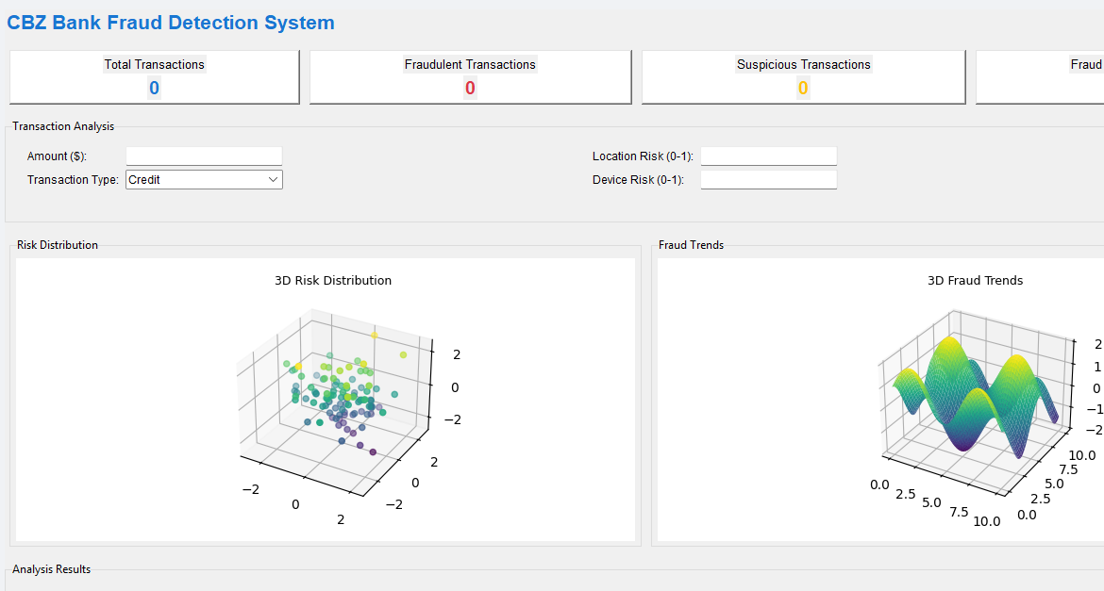
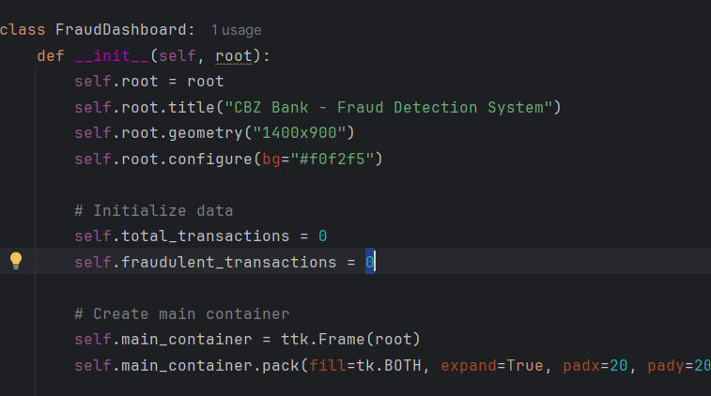
Code Presentation & Output:
01
02
0
ABOVE SHOWS THE CODE INPUT AND THE INPUT FOR THE GUI.

Slide 5
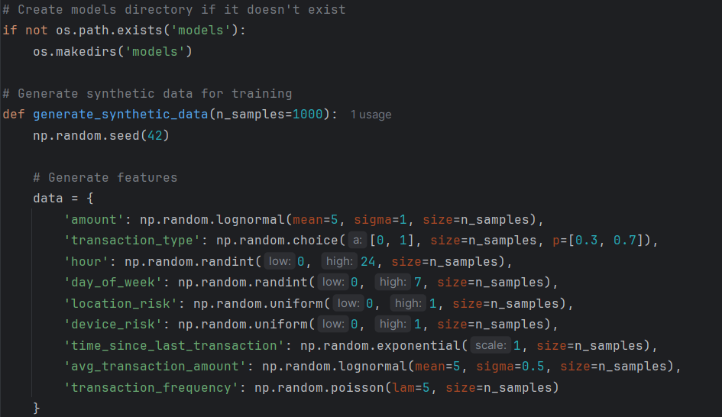
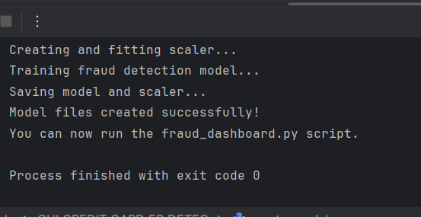
CODE PRESENTATION FOR ML TRAINING
1
CREATE MODEL.PY WILL TRAIN THE FRAUD_DASHBOARD.PY SO IT CAN FUNCTION PROPERLY.

Slide 6
THANKYOU

